Slide 2
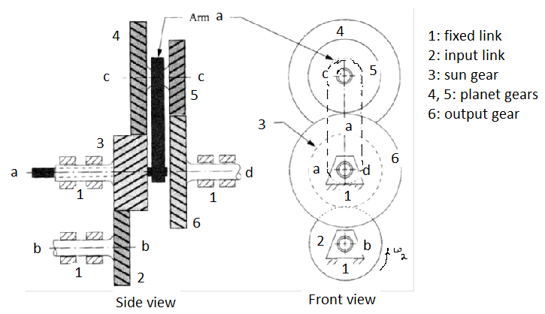

Slide 3


$$ω$$
$$v$$

Slide 4




$$v_{c}$$
$$L_{c}$$
$$ω$$
$$Reference Field$$

Slide 5












$$R_{d}$$
$$R_{c}$$
$$L_{d}$$
$$3$$
$$L_{q}$$
$$v_{o}$$
$$1$$
$$v_{c}$$
$$L_{c}$$
$$2$$
$$4$$
$$R_{q}$$

Slide 6



$$A$$
$$v_{i}$$
$$v_{o}$$

Slide 7

$$K_{d}$$
$$v_{i}$$
$$v_{o}$$

Slide 8
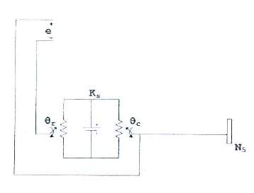
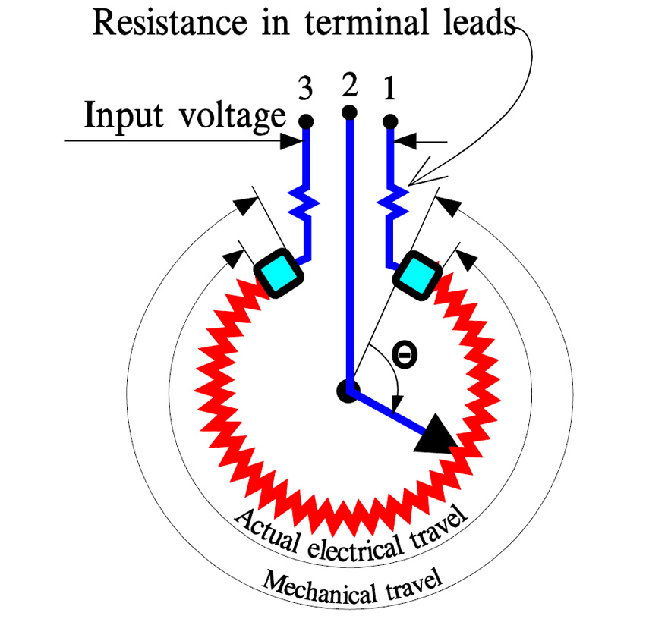
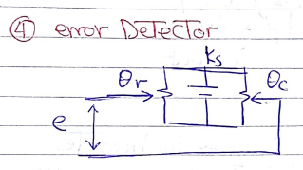



$$θ_{r}$$
$$θ_{c}$$
$$v_{error}$$

Slide 9
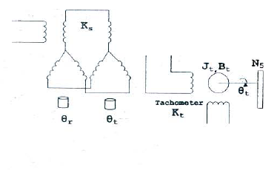
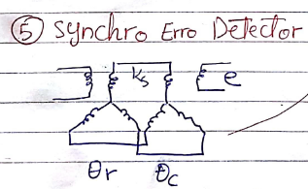
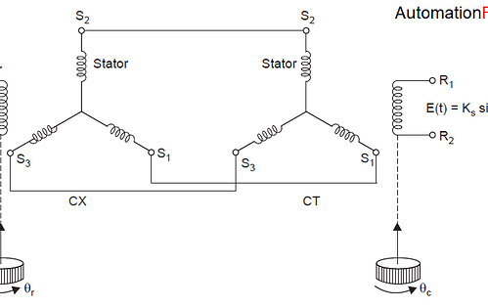

Slide 10


$$θ_{r}$$
$$θ_{c}$$

